Slide 1
The Theory Ladenness of Experiment
Allan Franklin
University of Colorado
Duesseldorf, Germany
March 10, 2011

Slide 2
“There is more to seeing than meets the eyeball.”
Norwood Russell Hanson (1958)

Slide 3
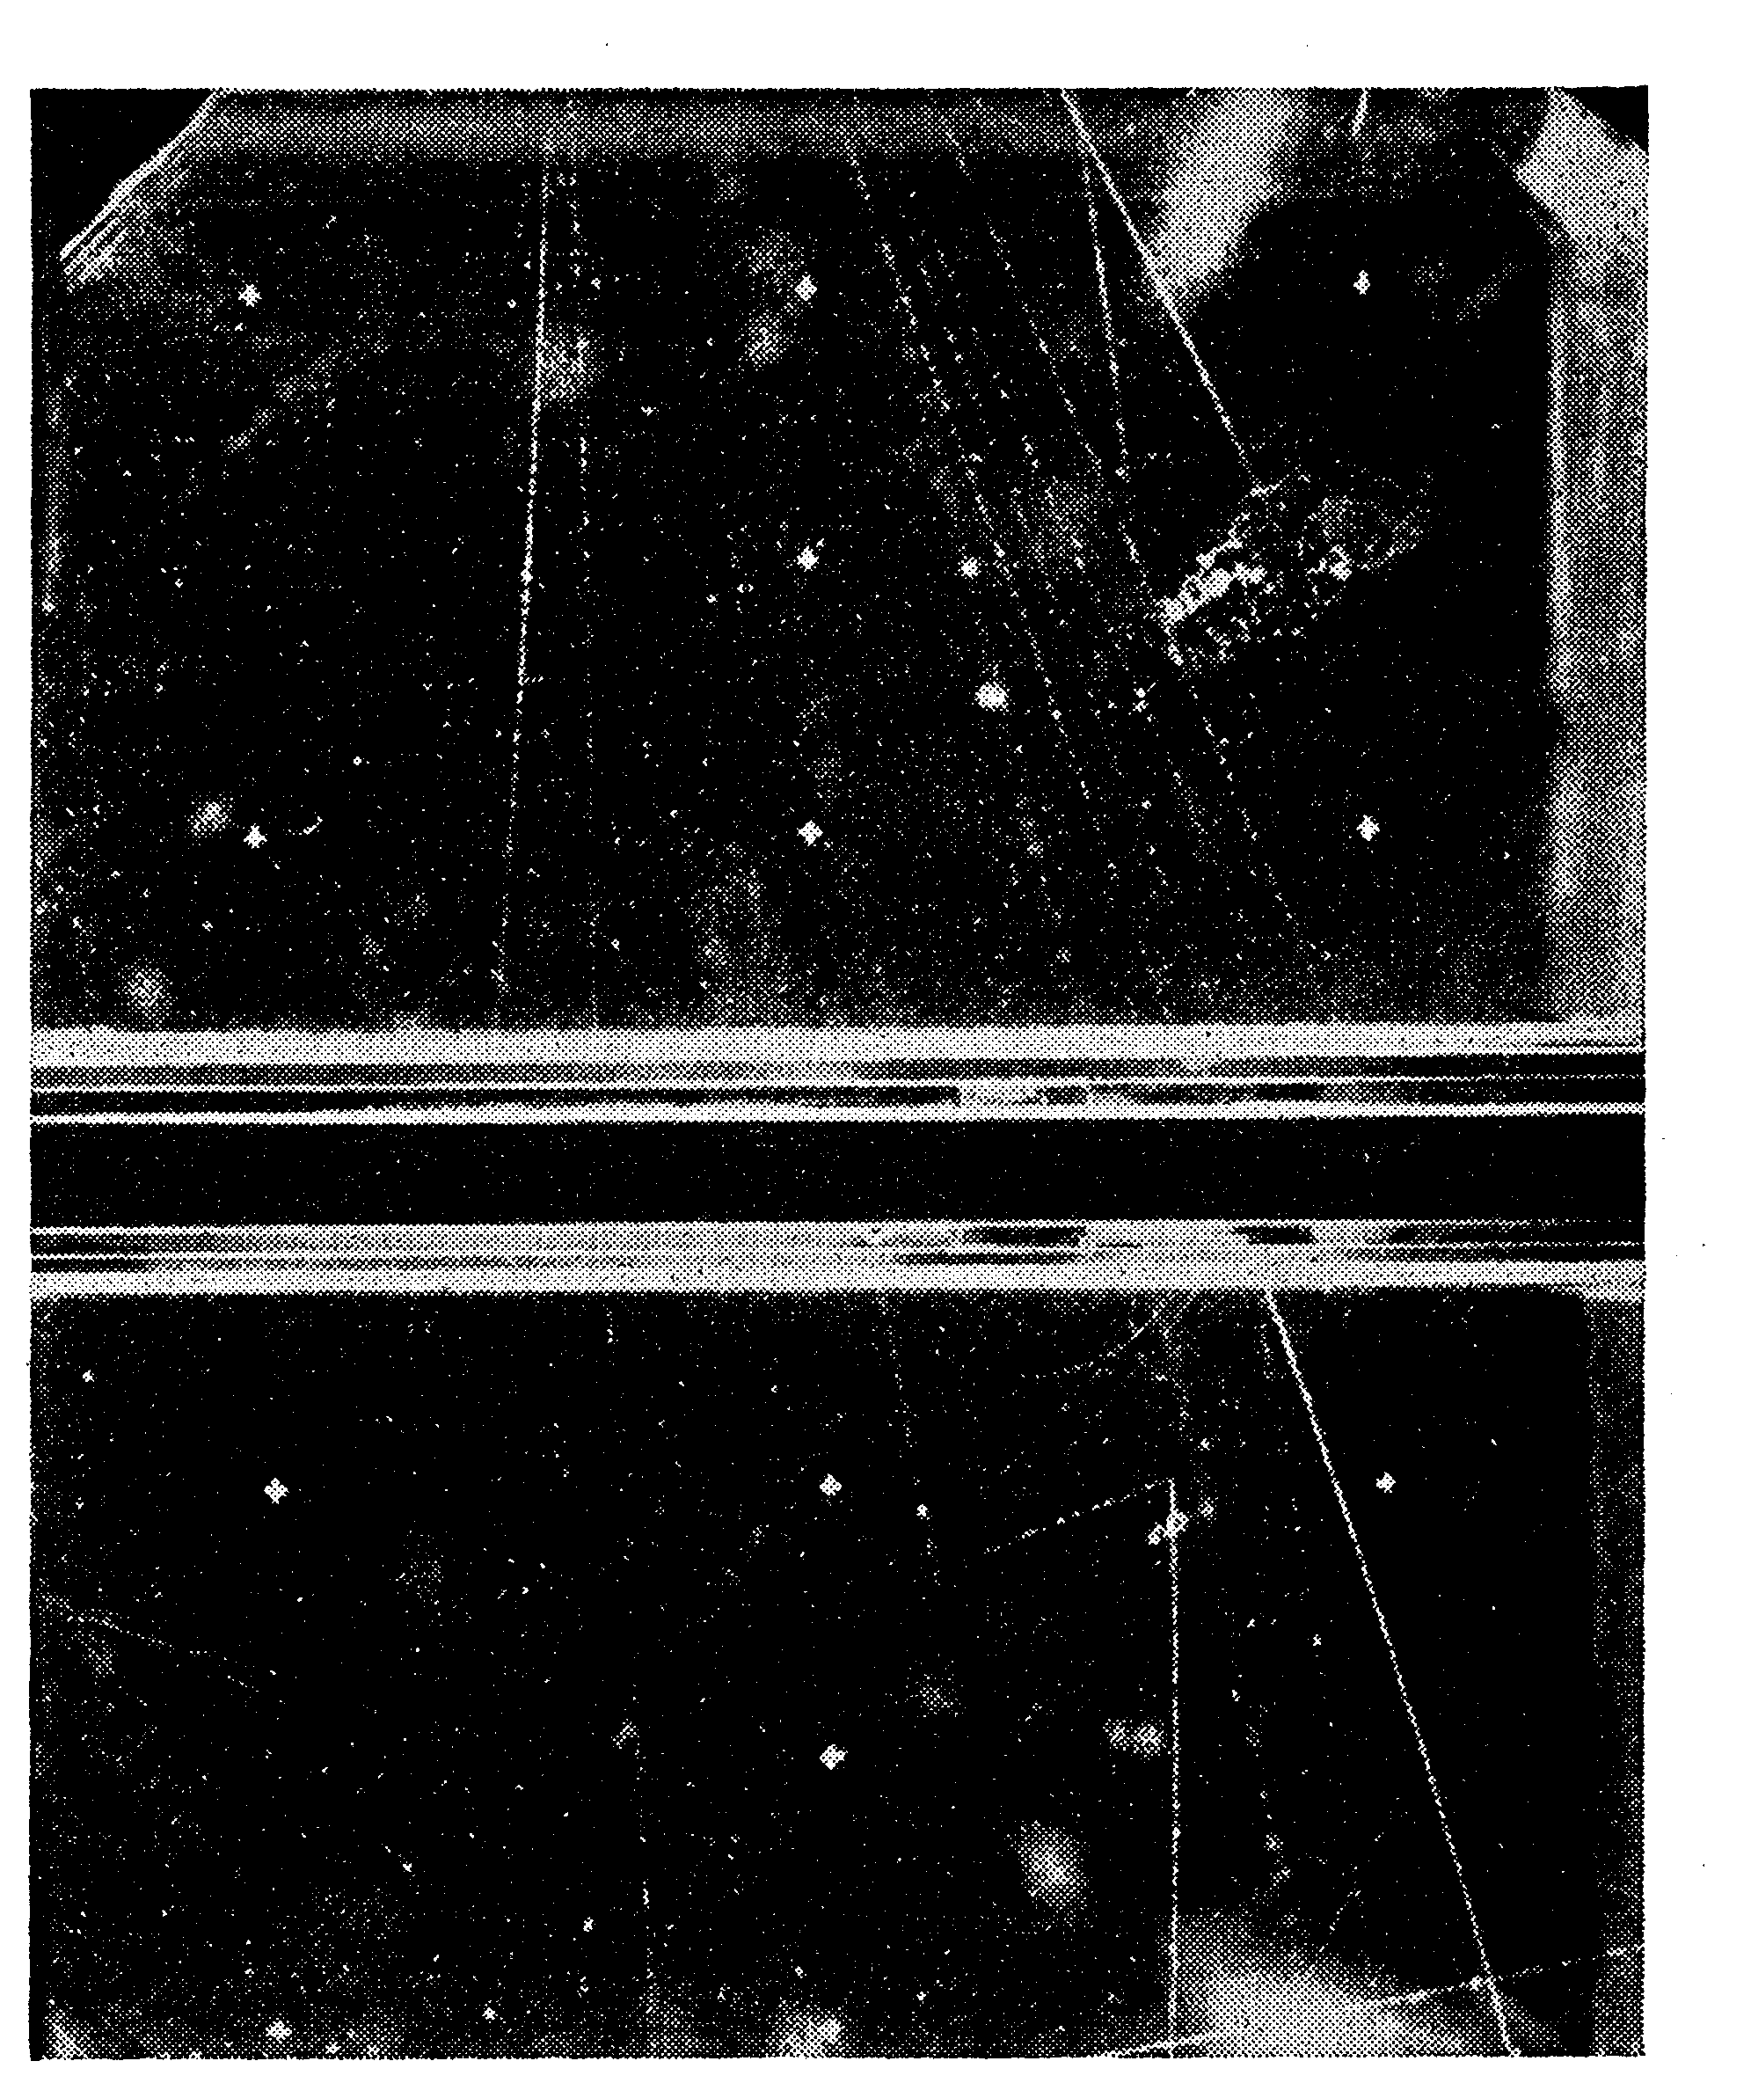

Slide 4
Theory Ladenness of Experiment
Philosophical
Practical
Can a theory-laden experiment test the theory?
Experimental Design
Failure to Observe,
Incorrect Interpretation, Possible Observational Bias
Are paradigms Incommensurable?

Slide 5
Observation cannot function as an unbiased way of testing theories because observational judgments are affected by the theoretical beliefs of the observer.

Slide 6
As Holmes remarked to Watson, “How often have I said to you that when you have eliminated the impossible, whatever remains, however improbable, must be the truth,”
Arthur Conan-Doyle

Slide 7
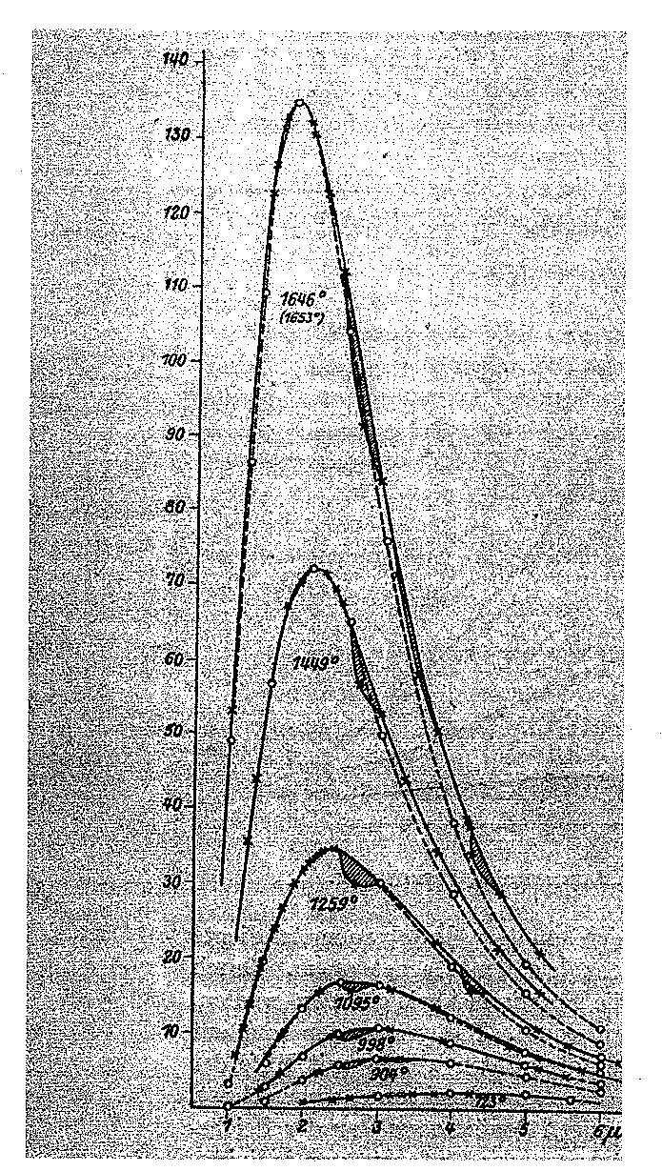

Slide 8
“There is no appropriate scale available with which to weigh the merits of alternative paradigms” they are incommensurable.”
Barry Barnes ( 1982)

Slide 9
m
m
Θ = 90º (Newton)
Θ < 90º (Einstein)

Slide 10
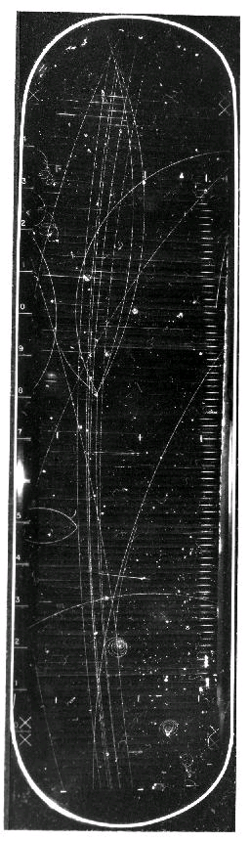

Slide 11
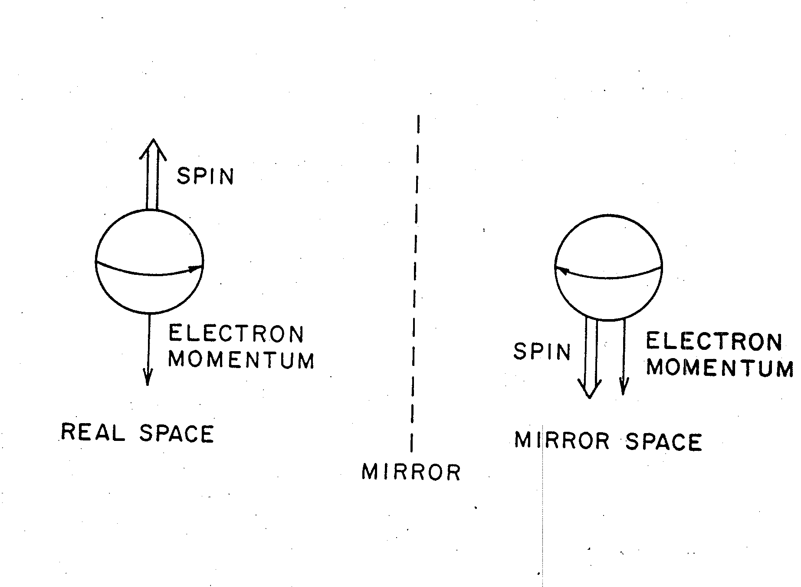

Slide 12
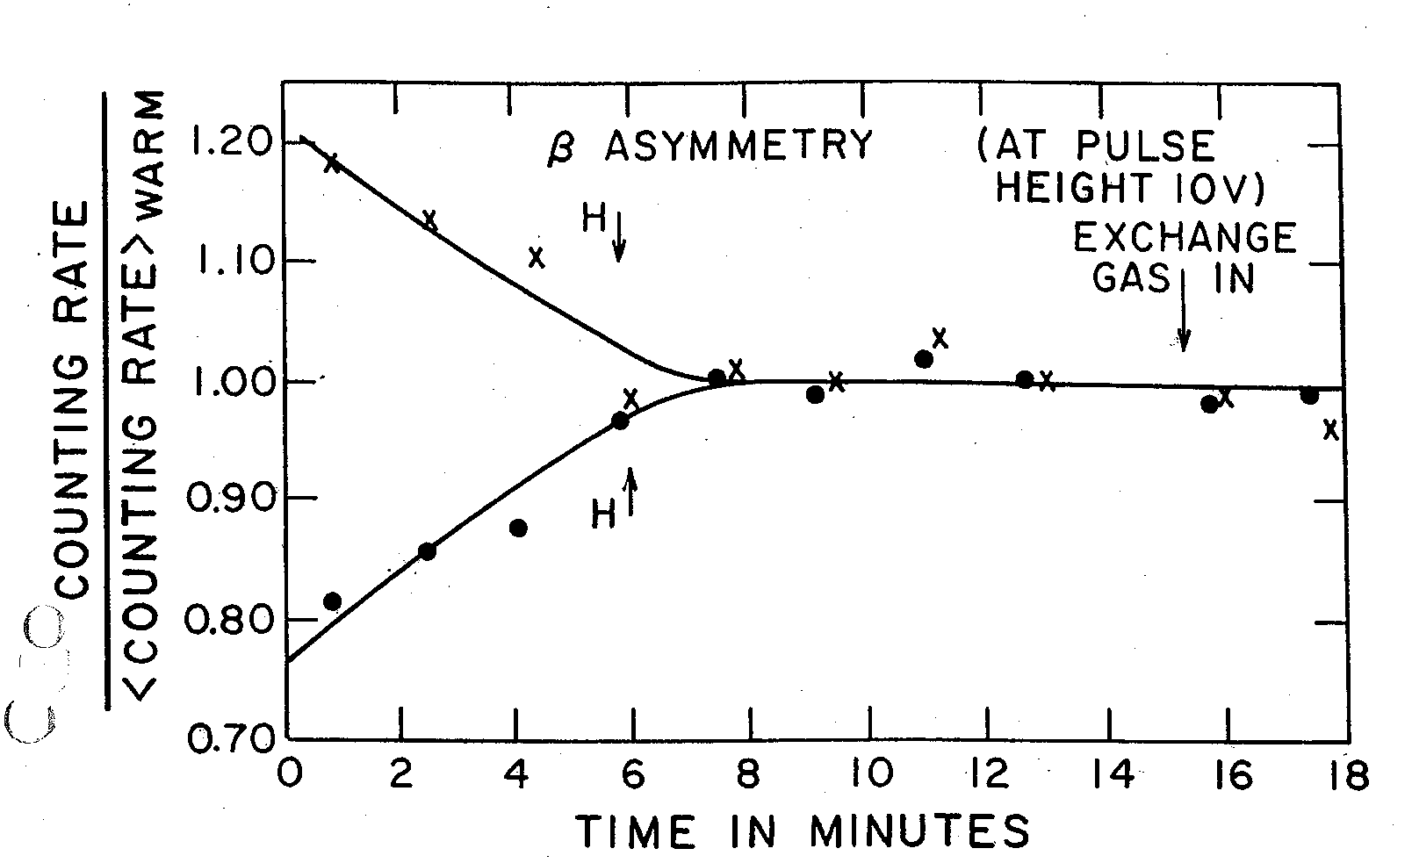

Slide 13
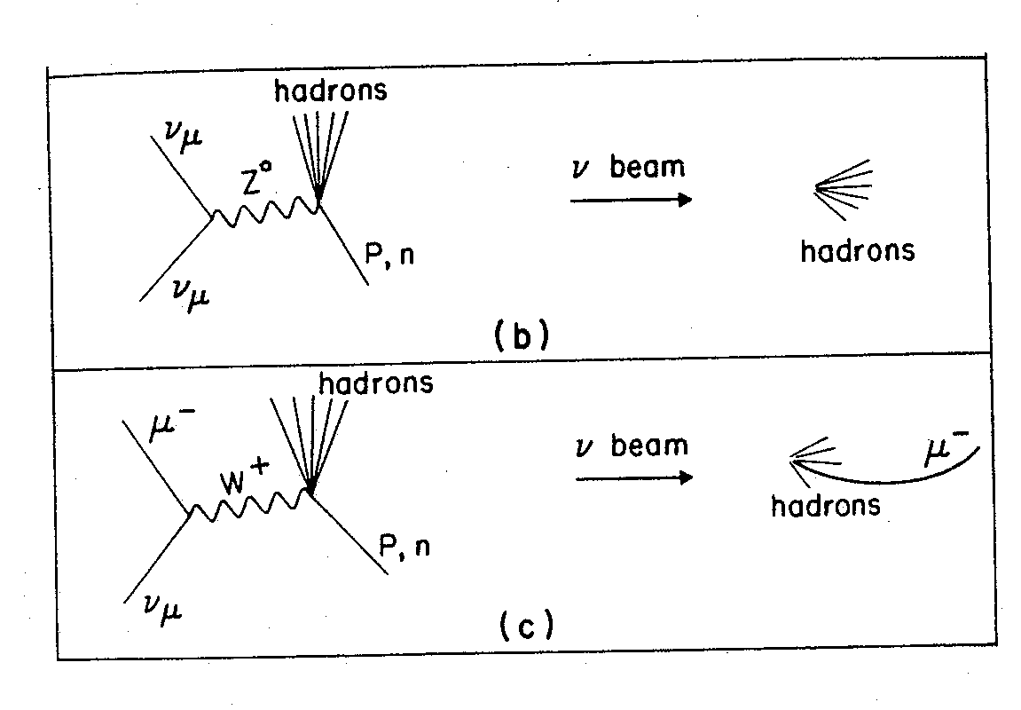

Slide 14
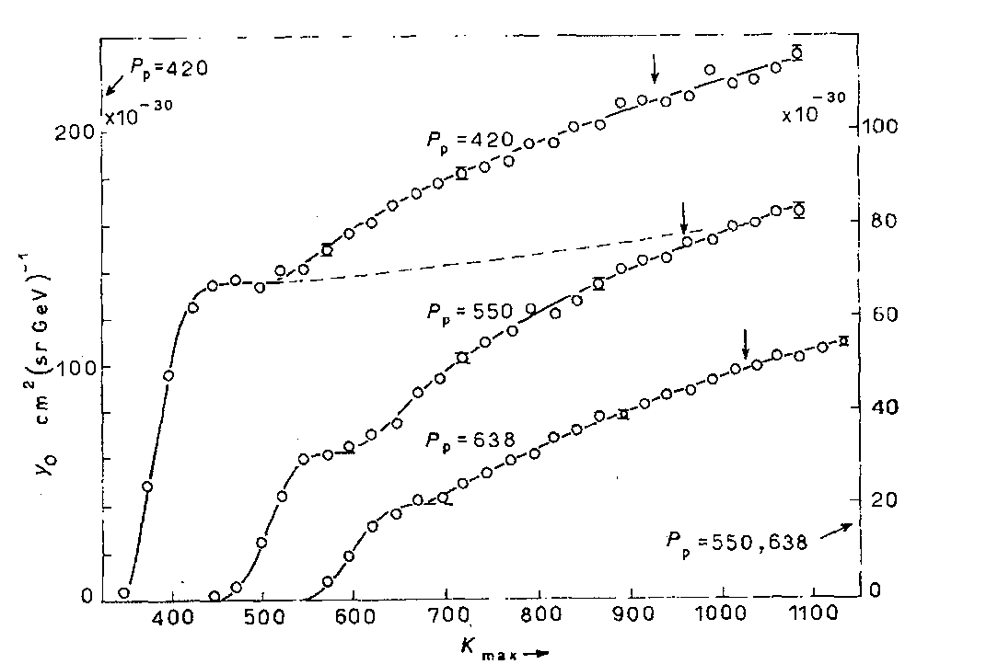

Slide 16
“ It should be remarked of several of these suggested explanations that their acceptance would offer greater difficulties in accounting for the discrepancies among the different results than would the acceptance of the hypothesis that we have here a true polarization due to the double scattering of asymmetrical electrons. ”
Cox et al. (1928)

Slide 17
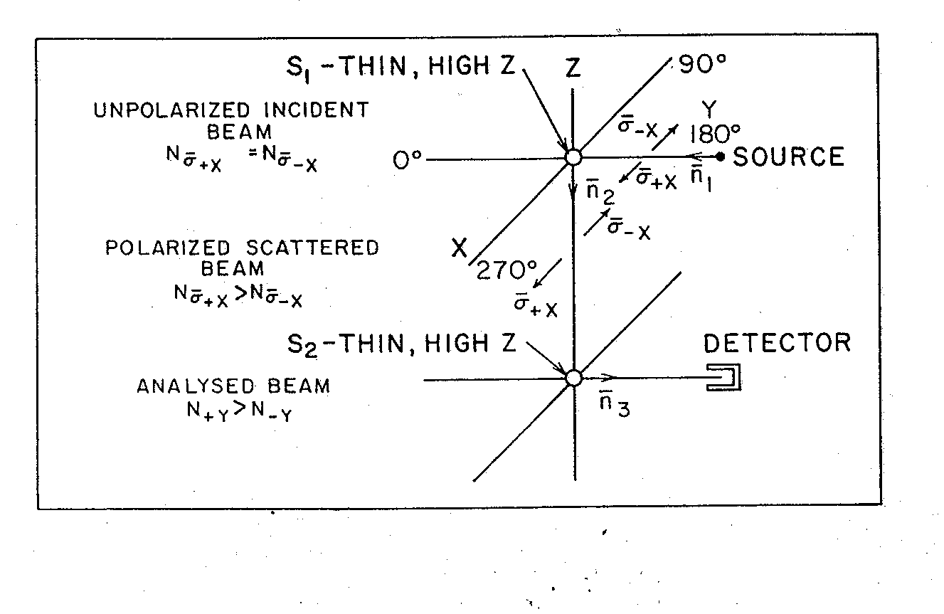

Slide 18
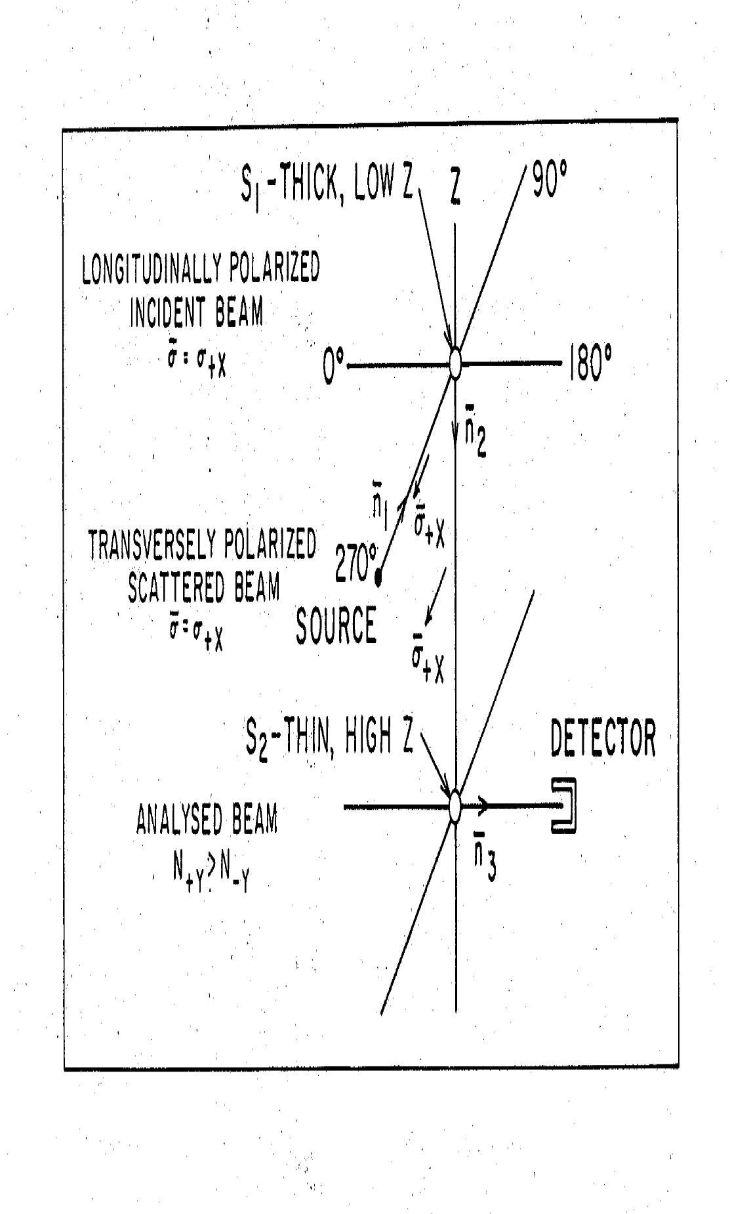

Slide 20
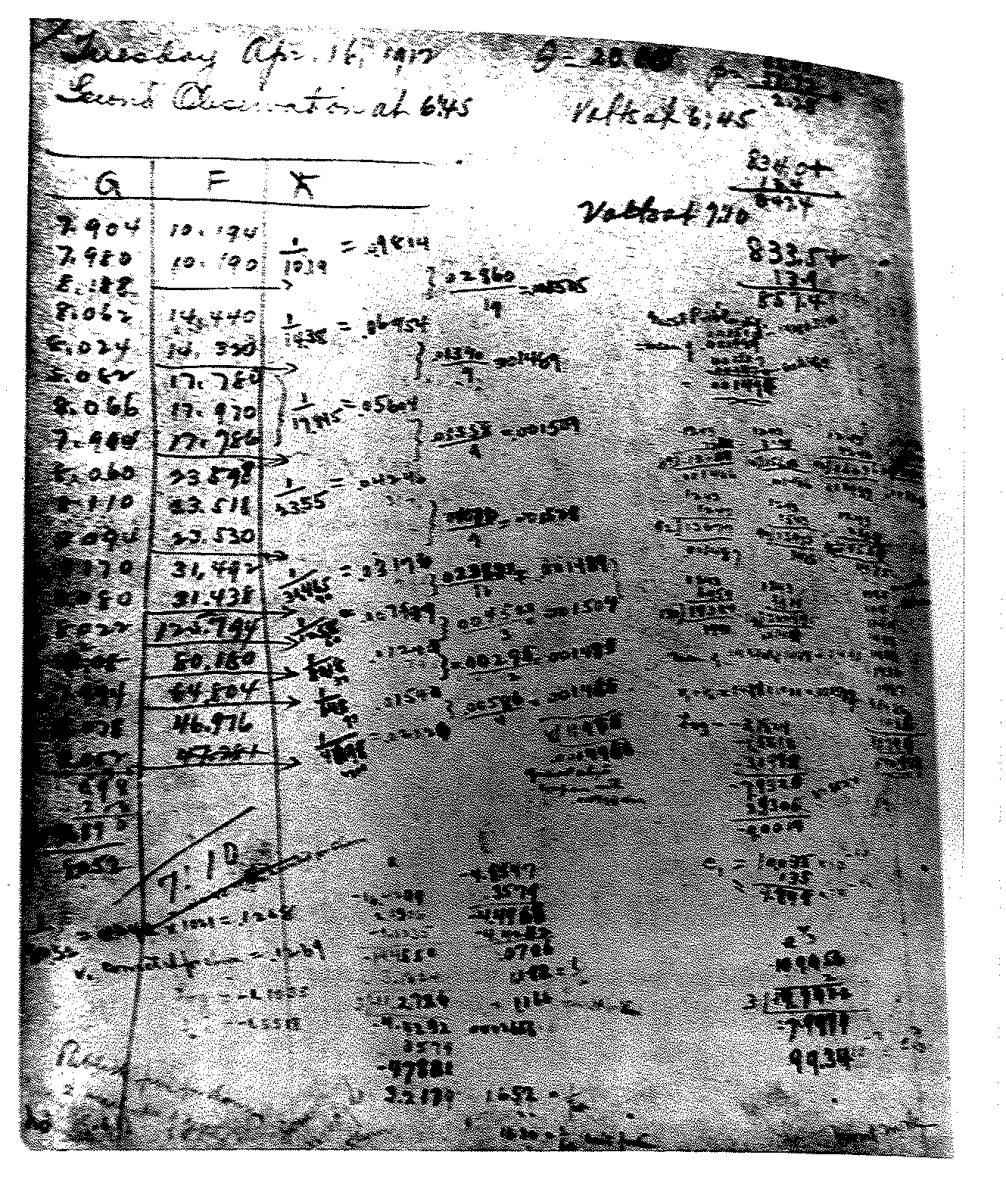

Slide 21
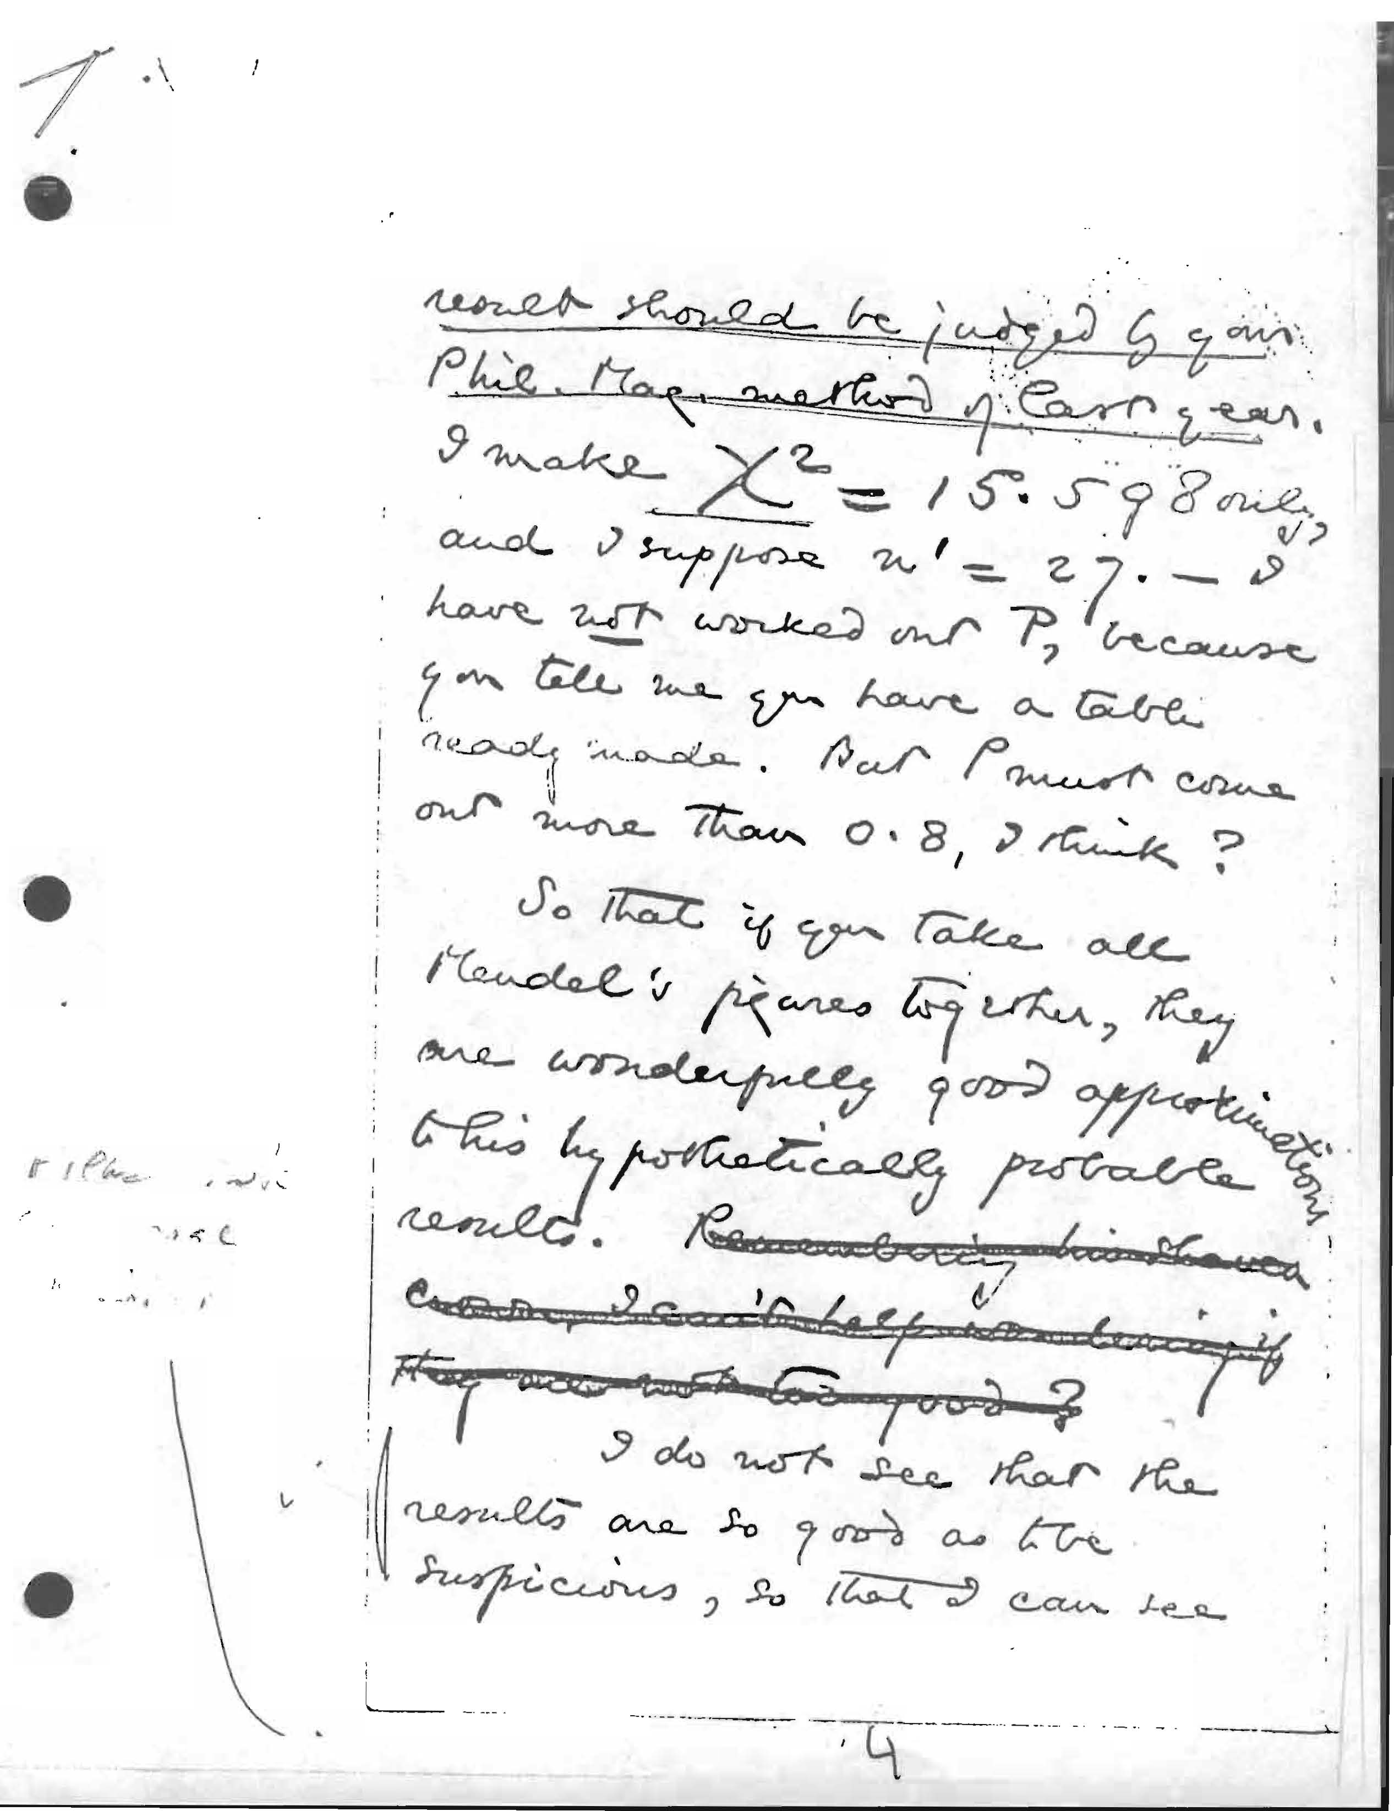

Slide 22
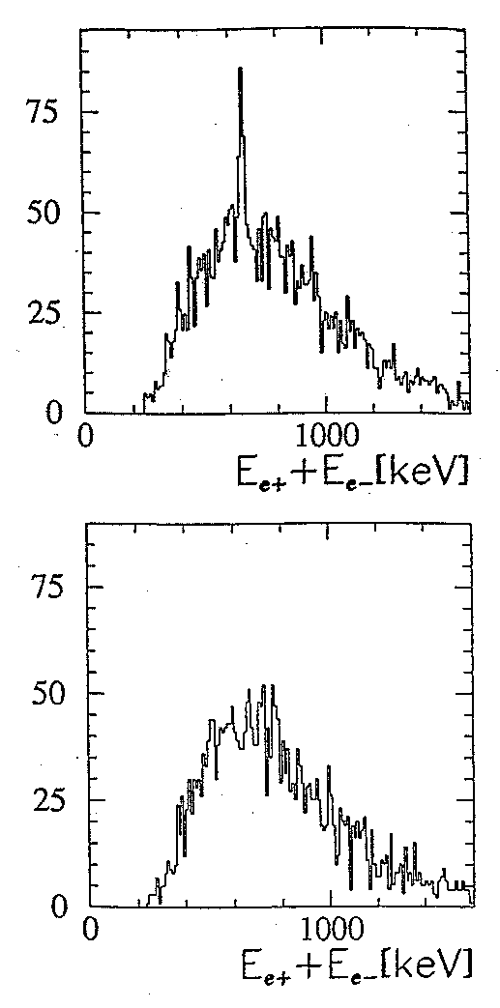

Slide 23


